Slide 1
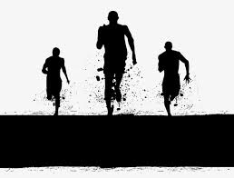
Get Fit, Get Lit
Presented By:
Hannah Andrews
Cody Buckley
Freddy Curiel
Zack Dominguez
Reinier Escalona

Slide 2

Member Roles:
Hannah Andrews: Manager and Front End
Cody Buckley: Float between Front End and Back End
Freddy Curiel: Back End and making sure both slides blend together
Zack Dominguez: Graphics and Back End development
Reinier Escalona: Front End and making sure Back End work efficiently with Front End

Slide 3
What is it?
We are putting together an application that helps people regulate a diet in order to get fit
How?
Contains a profile page during sign in
Provides an array list of food options
Pre-made diet plans and options
Embedded fitness articles and videos

Slide 4
Pages
Login Screen
Home Screen
Profile Screen
Foods Screen
Sign Out Message Screen
Diary

Slide 5
Project Plan
10/25: Presentation 1
11/10: Test results will be concluded
11/18: User’s manual complete
11/20: Source, Executable, Build Instructions
11/25: Completed Program
11/30: Presentation 2 complete

Slide 6
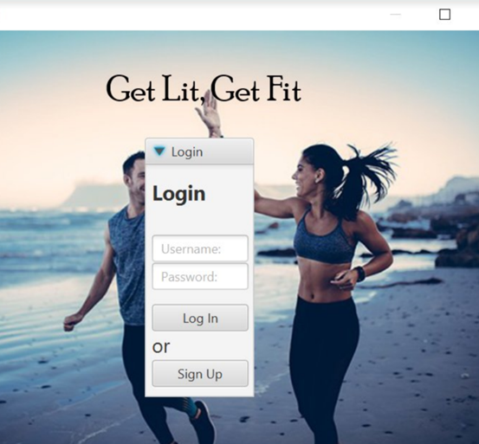
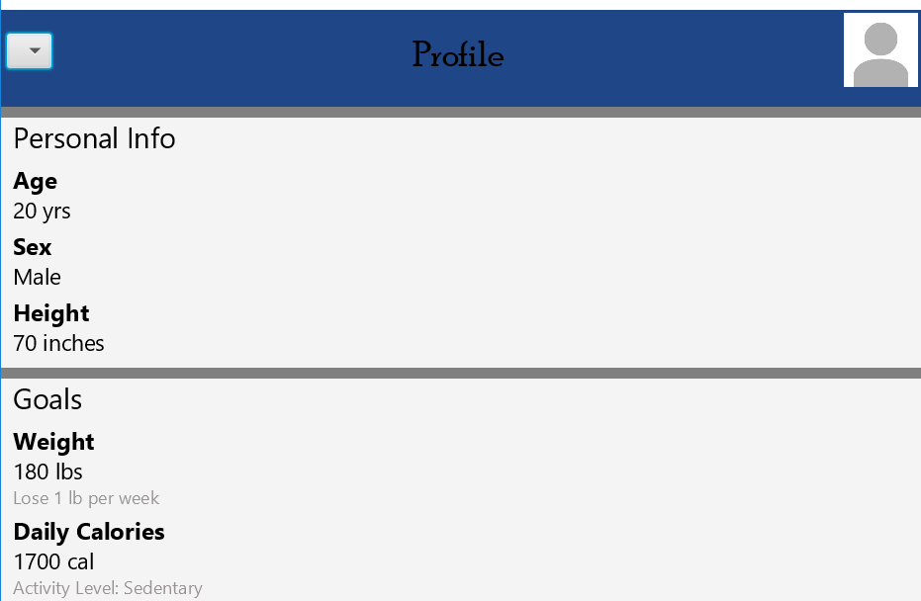
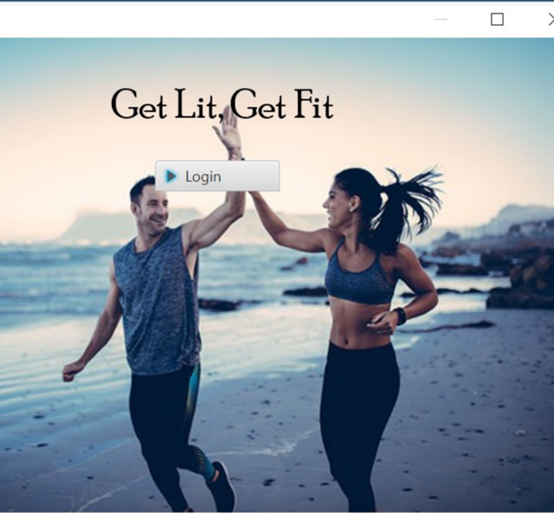
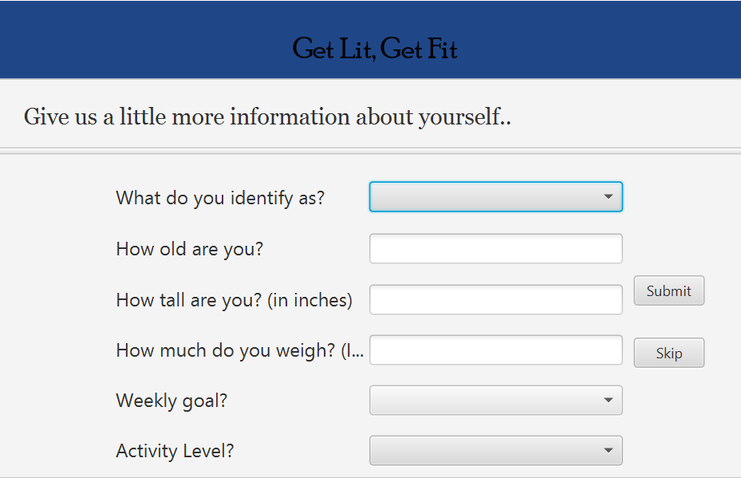
Page View

Slide 7
Video Example
https://youtu.be/9HynJuV_TOo

Slide 8
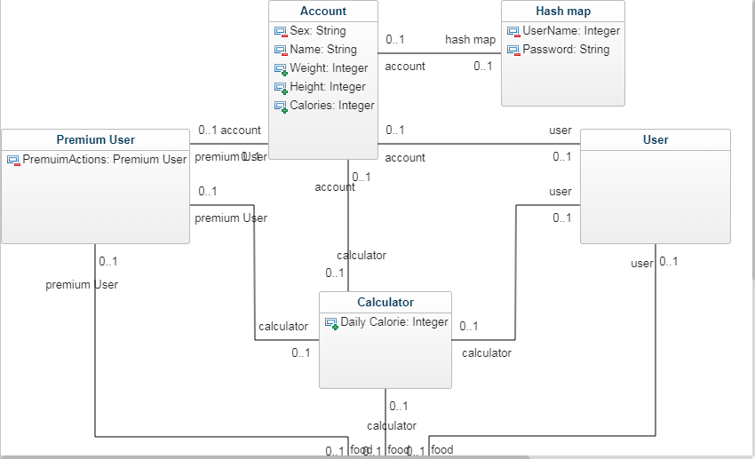
Class Diagram

Slide 9
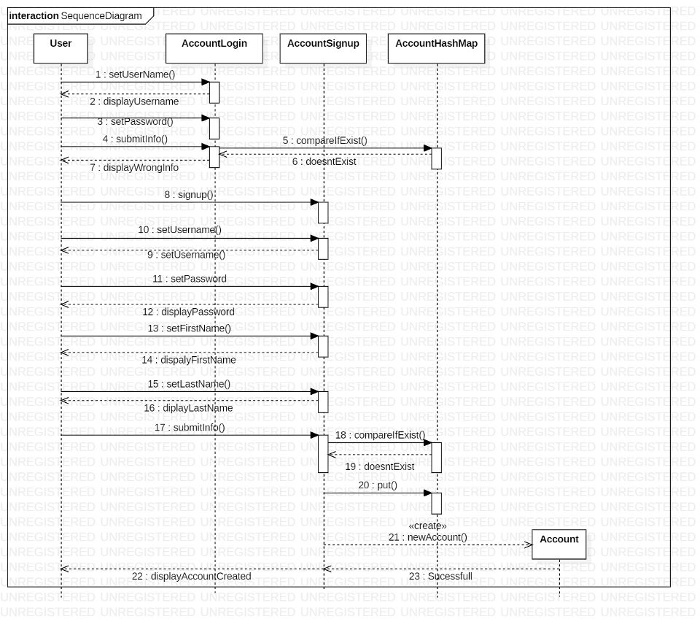
Sequence Diagram

Slide 10
Next Steps
Create an observable list with foods on it that can be searchable and have the user be able to select it – Freddy and Zack
1
Incorporate and embed fitness video’s and articles for the user to view in the home page– Hannah, Cody, and Reinier
2
Create a visual for the goals and diary pages for the application – Hannah, Cody, and Reinier
3
Code functions onto the buttons and clickable items made for the goals and diary pages – Freddy and Zack
4

Slide 11

Challenges and Decisions
One decision we need to make is whether we want to embed the articles and video’s or just have links to them
One challenge is to be able to embed articles to the home page and set them to where the user can scroll through and read it on the page
We also need to decide what the Diary tab will display

Slide 12

Questions?

